Slide 1
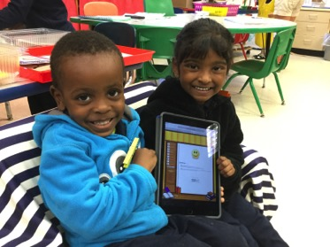
2016 Promising Practice Conference TECHNOLOGY INTEGRATION
WEST HERTEL ACADEMY
Buffalo, NY
Public School #94
Presented by:
Cecelie Owens
Kaitlin Gillis
Kelsey Roe
Alicia Murphy
Sylvia Morsellino
Jennifer Scalisi
Marshell Anderson
Jashell Love

Slide 2
Receivership Status and Demonstrable Growth Targets
Targets | Baseline Year 2013 -14 | 2015-16 Results | Target For 2016-17
Increase NYS ELA scores 3-8 (Level 2 and above) | 25% | 34% | 37%
Increase NYS Math Scores 3-8(Level 2 and above) | 29% | 30% | 33%
Grades 4 and 8 Science (Level 3 and above) | 32% | 37% | 40%
Teacher Practices and Decisions(DTSDE Tenet 4 –according to rubric) | Ineffective | Developing | Effective
Increase ELA scores for subgroup LEP students (Level 2 and above) | 15% | 18% | 21%
Increase ELA scores for subgroup Black students (Level 2 and above) | 19% | 27% | 30%
Priority School makes yearly progress | NA | NA | Make Progress
School Safety | 12 | 13 | <6
Student Suspension Rate- Long Term (Out of School) | 17% | 15.09% | 10%
Providing 200 hours of extended day learning time (ELT) | NA | Met | 200 hrs

Slide 3
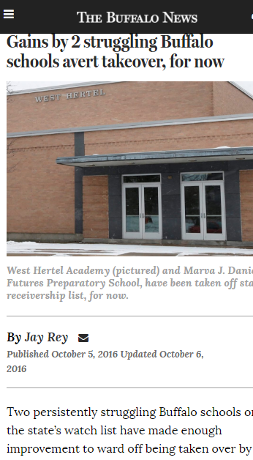
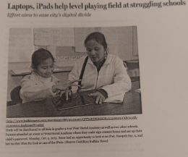
West Hertel Academy Makes necessary Demonstrable growth

Slide 4
School Mission Statement
West Hertel Academy is working together, in partnership with teachers, family and the community, to motivate all students to reach their social-emotional and academic potential through innovation and change.

Slide 5
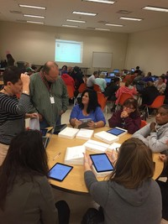
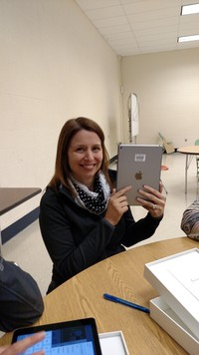
Getting Ready!
Teacher training
District Technology Support
Digital Citizenship for all
Acceptable use policies
Informing parents
Town Hall Meeting

Slide 6
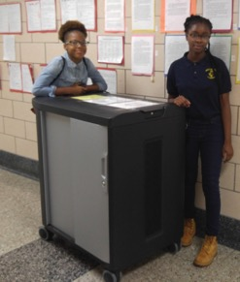
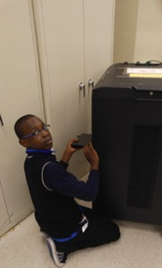
Technology Rollout
Ambassador training
Inventory and Travel plans for laptops
Cafeteria Plan
1:1 Technology Handbook

Slide 7
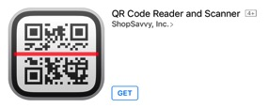
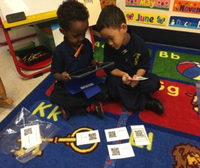
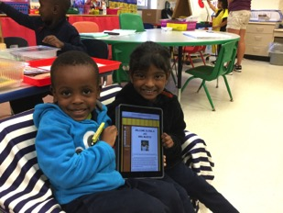
Building literacy and communication skills through technology in Pre-K
iMovie
Shadow puppet
QR codes and scanners
Mrs. Murphy’s Classroom website

Slide 8
FIRST & SECOND GRADE ENL PROJECT USING TECHNOLOGY

Slide 9
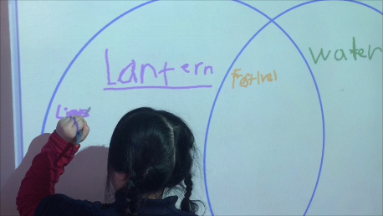

Slide 10
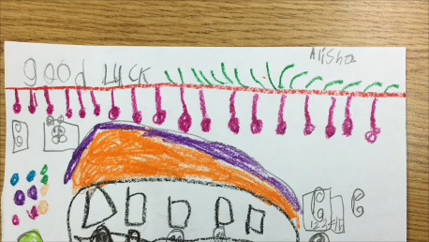
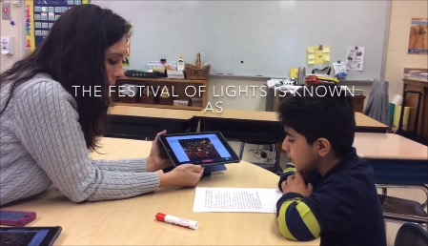

Slide 11
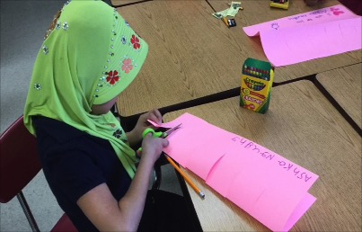
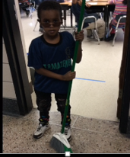

Slide 13
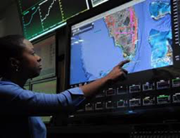
College and Career Readiness Jennifer Scalisi – Home & Careers
The need to conduct research and to produce and consume media is embedded into every aspect of today’s curriculum.
The skills and understandings students are expected to demonstrate have wide applicability outside the classroom or workplace.

Slide 14
Technology Website: O-NETonline
Occupational Information Network-
https://www.onetonline.org/
This website has detailed descriptions of the world of work for students to:
Explore occupations by career clusters, abilities, skills
Conduct research and produce a written summary of a selected occupation
Compare the salaries and job outlook of an occupation
Helps students focus on their educational plans
Visit websites of colleges and universities
Experience using a job bank

Slide 15
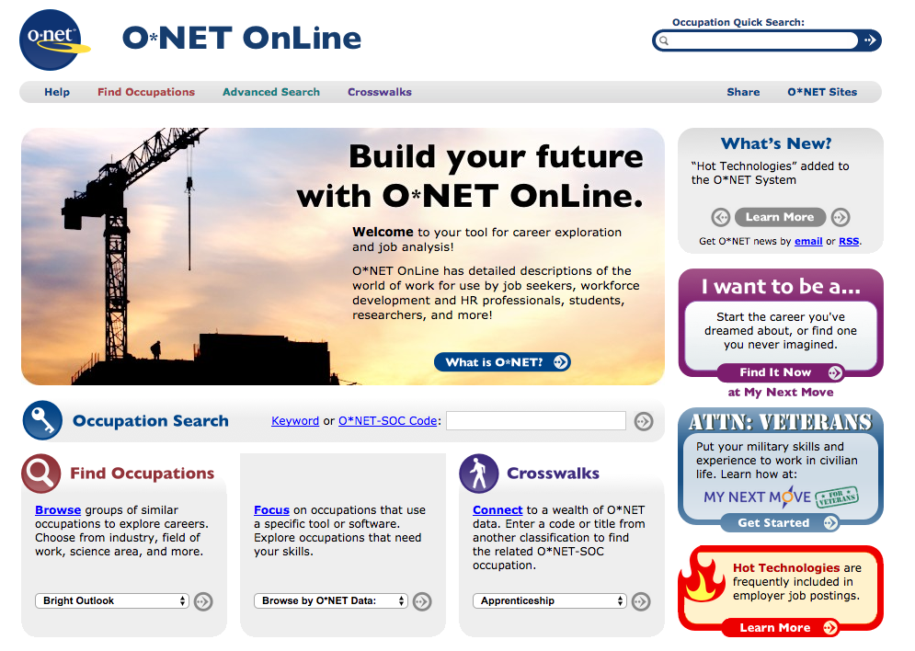

Slide 16
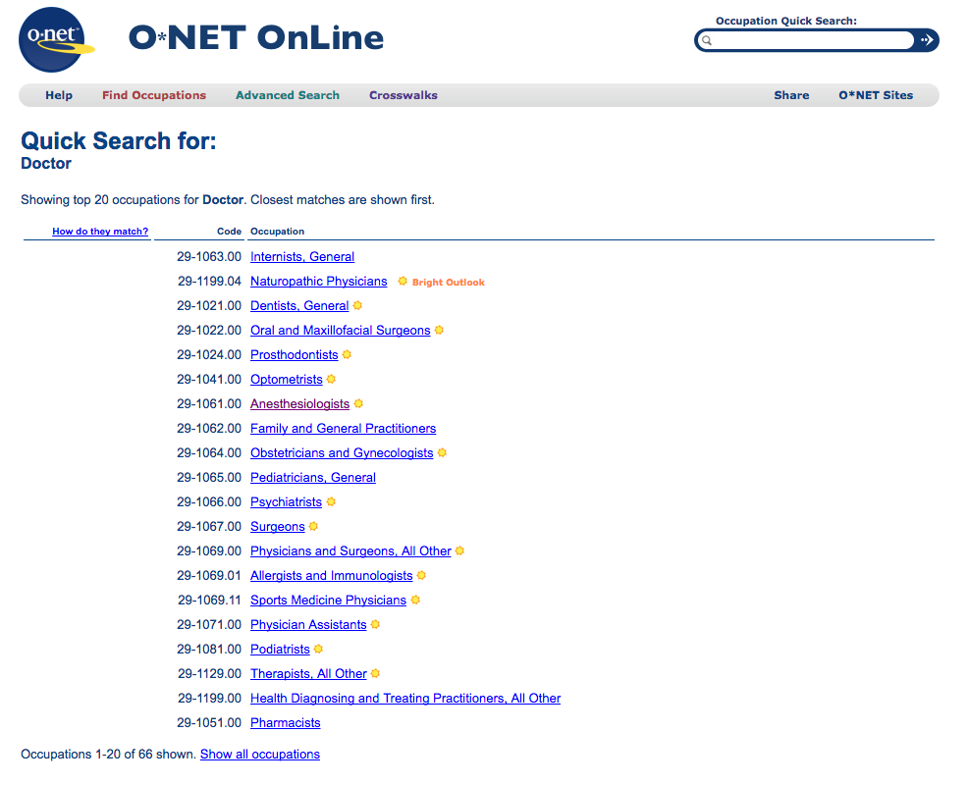

Slide 17
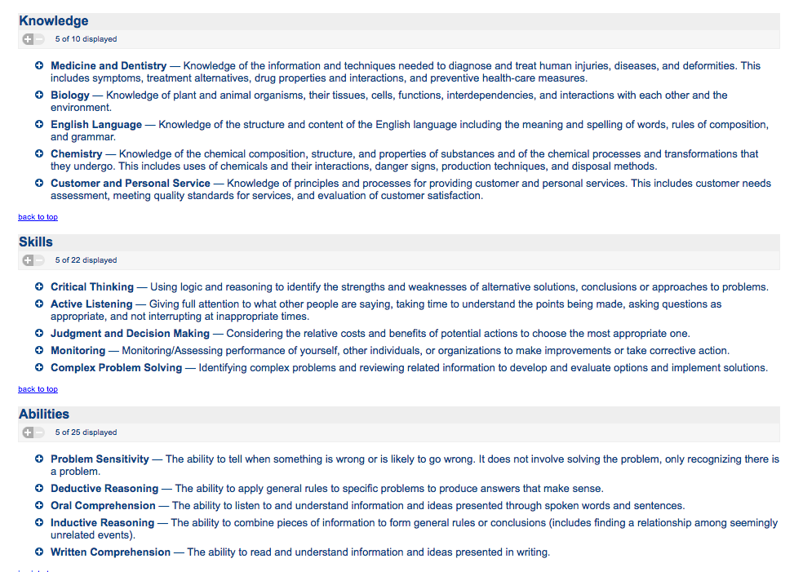

Slide 19
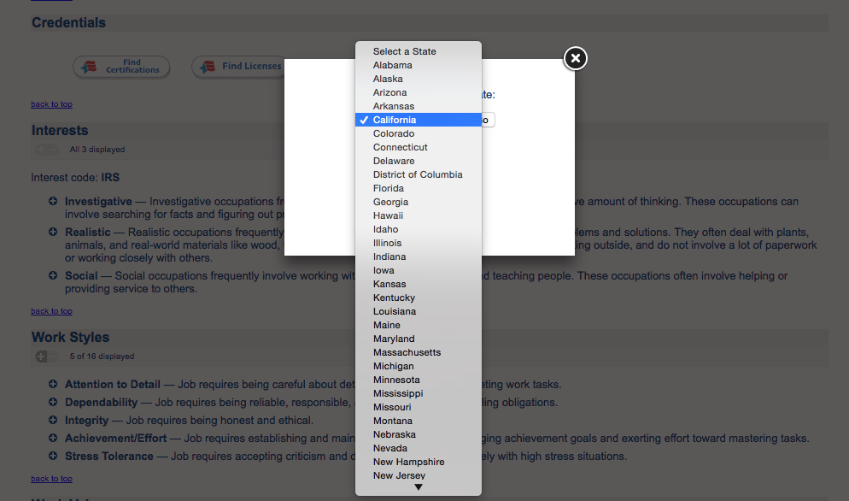

Slide 20
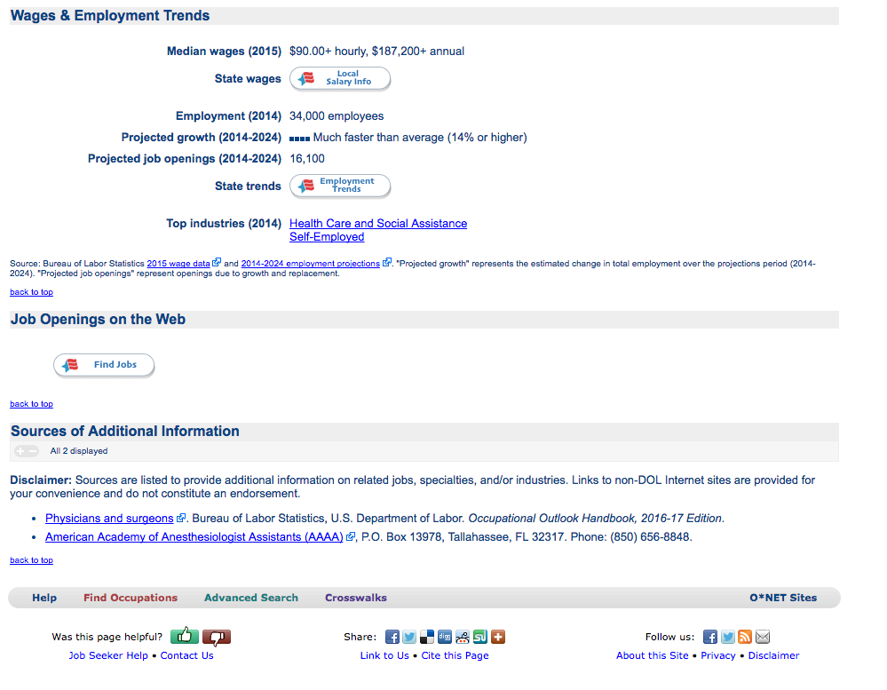

Slide 21
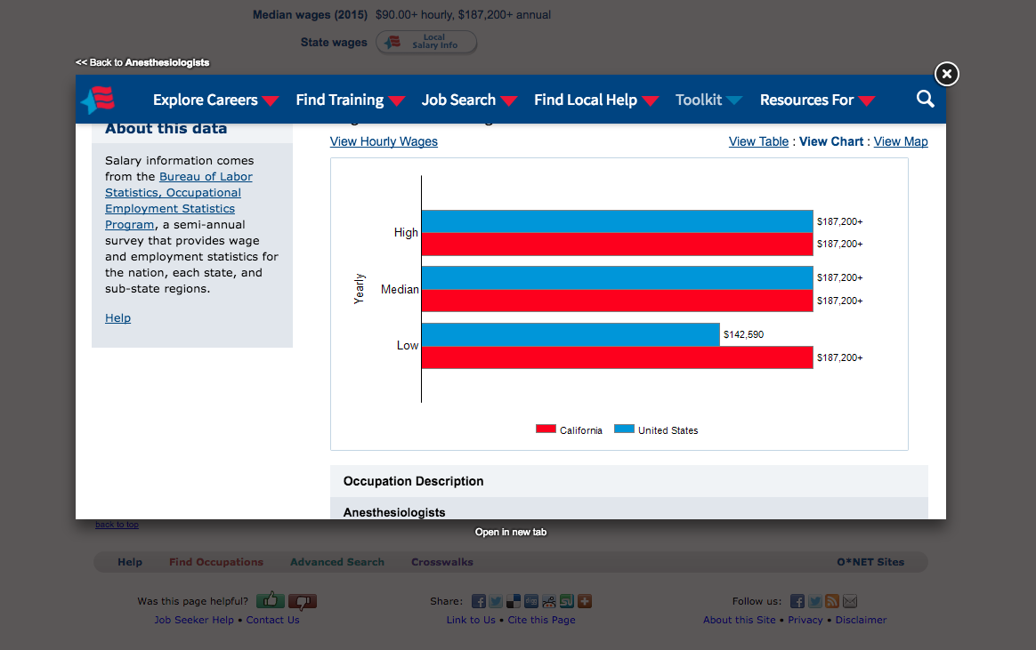

Slide 23
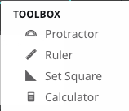
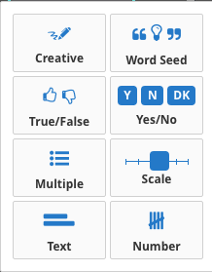
STUDENT ENGAGEMENT
Limits distractions
Demands attention
Interactive
All inclusive
Increased participation
Minimizes call outs

Slide 24
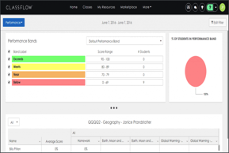
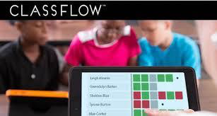
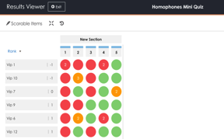
DATA DRIVEN
All Inclusive
Immediate
Better gauge of student needs
Time saver
Organized
Specific & Immediate feedback

Slide 25
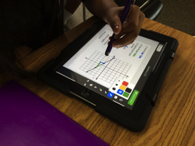
INNOVATION & CHANGE
Exposure to 21st century tools
More opportunity for student led lessons
College & Career readiness
Promotes curiosity & problem solving
A world of resources

Slide 26
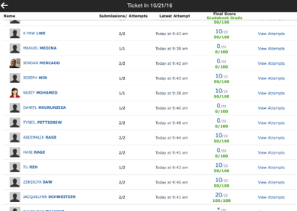
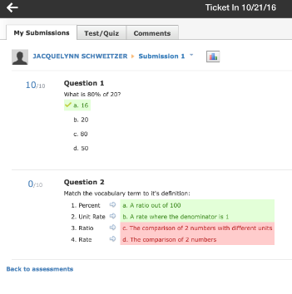
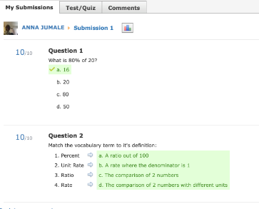
IMMEDIATE FEEDBACK WITH TECHNOLOGY
Ticket In
Exit Tickets
Unit Review

Slide 27
Thank you for our Technology!

